Slide 1
Multivariate Regression with Categorical Responses
Robert Nakano robertnakano@gmail.com
Sunny Jelokhani
Ziyi Wang
Link to slides: https://tinyurl.com/yatpwo83

Slide 2
Question:
We’ve learned how to model with a numeric response variable
Picture of linear regression we did in class
But, What if the response variable (Y) iS NOT NUmeriC?

Slide 3
Today, we’ll talk about
Overview of Categorical Reponses
Case Study : Predicting personalities (binary)
Case Study: Epidemic outbreak of a disease ( ordinal)

Slide 4
Categorical Data & Reponses
What is a categorical response?
Response data that is measured by categories instead of continuously.
Also called: Qualitative (vs. quantitative),
Examples:

Slide 5
Type of Categorical Responses
Binary: 1 or 0
The response variable is one of two things.
For instance,
(EXAMPLES, can expand to multiple slides)
Male or Female
Smoker or Non-smoker
Netflix: THumbs up THumbs down
Pregnant or Not Pregnant
People who dance in front of the mirror or People who Don’t Dance in front of the mirror (picture)
Miss your ex-boyfriend/girlfriend or DON’T miss an ex.
Poll Dancer or NON poll dancer.
Kissed in the Rain or never kissed in the rain.
(MAKE PRETTY)

Slide 6
If a variable is not binary, it is Polytomous
Polytomous (more than 1 outcome)

Slide 7
Type of Polytomous: Categorical Responses
Ordinal: On an ordered spectrum
Multiple Categories that can be ordered.
EXAMPLES:
E.g. How much do you like Dr. Ath’s class?
(1 - 4)
Love it 2. Best class ever 3.Would Leave my spouse to take it. 4. Better than Game of THrones
How much do you like Hide in Heels (FIX ME)?
1 2 3 4 5
Hate itDOn’t like it, 3. It’s ok, 4. I like it 5. Love it!
E.g. Netflix old star system

Slide 8
Type of Polytomous: Categorical Responses
Ordinal: On an ordered spectrum
Multiple Categories that can be ordered.
EXAMPLES:
E.g. How much do you like Dr. Ath’s class?
(1 - 4)
Love it 2. Best class ever 3.Would Leave my spouse to take it. 4. Better than Game of THrones
(insert crappy show hear)
Interval: numerical distance between data points

Slide 9
Type of Categorical Responses: Nominal
Nominal has no order
E.g. Worst TV show is (izombie, etc.)
Possible Answers:
Who is your favorite singer?
Taylor Swift, The Biebs, Beyonce, Shakira, Robert Nakano
Favorite Dessert: Tira misu. Chocoalte cake. CHocolate Souffle, Beef jerky , Froyo!

Slide 10
HOW DO YOU predict A Categorical Response?
It depends on what kind...

Slide 11
HOW DO YOU predict A Categorical Response?
It depends on what kind: PERHAPS :
Binary-> Logistic Regression
Ordinal-> UNEVEN INTERVALS -> Logistic Regression
Ordinal with even intervals -> Logistic Regression OR (decision tree) OR Linear Regression (like Ryan’s presentation on Predicting Map Difficulty with Dancing)
Nominal: multinomial logit mode

Slide 12
How to predict a categorical response?
In statistics, logistic regression, or logit regression, or logit model^{[1]} is a regression model where the dependent variable (DV) is categorical.
WHY LOGISTIC REGRESSION IS NEEDED
1. The residuals cannot be normally distributed (as the OLS model assumes), since they can only take on one of several values for each combination of level of the Independent Variables
2. The OLS model makes nonsensical predictions, since the DV is not continuous - e.g., it may predict that someone does something more than ‘all the time’. Something like 1.3 doesn’t make sense in a binary response.
3. For nominal DVs, the coding is completely arbitrary.
For Ordinal Data, it might (not sure if it does) make sense if they are evenly spaced. E.g. 4.5 stars out of 5 (e.g. Ryan’s presentation)

Slide 13
When can/can’t you use logistic regression?
Don’t Need
Doesn’t need to be linear (red xs or a cancel)
Distribution doesn’t need to be normal (red xs)
Do Need:
Binary or ordinal data (green checkmarks)
Independent observations (no matched data) (green checkmarks)
Independent variables need to be linearly related to the log odds (green checkmarks)
Notes:
http://www.statisticssolutions.com/assumptions-of-logistic-regression/

Slide 14


Logistic Regression Formula:

Slide 15
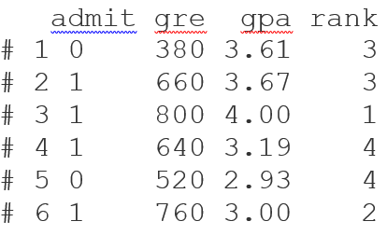
How to predict a categorical response?
Binary:
binary logistic model is used to estimate the probability of a binary response based on one or more predictor (or independent) variables (features). It allows one to say that the presence of a risk factor increases the odds of a given outcome by a specific factor. The model is a direct probability model and not a classifier.
Example:
The primary purpose of the study was to define how variables, such as GRE
https://en.wikipedia.org/wiki/Logistic_regression
Response (y)
Independent Variables (Xs)
Notes:
http://www.data-mania.com/blog/logistic-regression-example-in-python/
https://www.lynda.com/Python-tutorials/Logistic-regression-model/520233/601977-4.html?org=colapublib.org

Slide 16
References for R, SAS, & Python
https://www.analyticsvidhya.com/blog/2015/08/comprehensive-guide-regression/
R tutorial on running a logistic regression:
https://www.r-bloggers.com/how-to-perform-a-logistic-regression-in-r/
R tutorial on building a logistic regression from scratch:
https://www.analyticsvidhya.com/blog/2015/10/basics-logistic-regression/
Python walkthrough: https://towardsdatascience.com/logistic-regression-using-python-sklearn-numpy-mnist-handwriting-recognition-matplotlib-a6b31e2b166a
https://towardsdatascience.com/building-a-logistic-regression-in-python-step-by-step-becd4d56c9c8
SAS example:
http://support.sas.com/documentation/cdl/en/statug/63962/HTML/default/viewer.htm#statug_logistic_sect060.htm

Slide 17
Do words indicate a certain temperament/personality?
Simpler question: Do using certain words indicate Introverted/Extroverterdness?

Slide 18
Case Study MBTI Text-Blogger and personality type correlation
Background: Certain words using indicate one’s personailties.
Overview of MBTi: youtopiaproject.com
Description of type of response?
Code:
Analysis

Slide 19
Case Study MBTI Text-Blogger and personality type correlation
Overview of MBTi:
INTJ
Introversion or Extroversion
iNtuition or Sensory
Feeling or Thinking
Perceiving or Judging

Slide 20
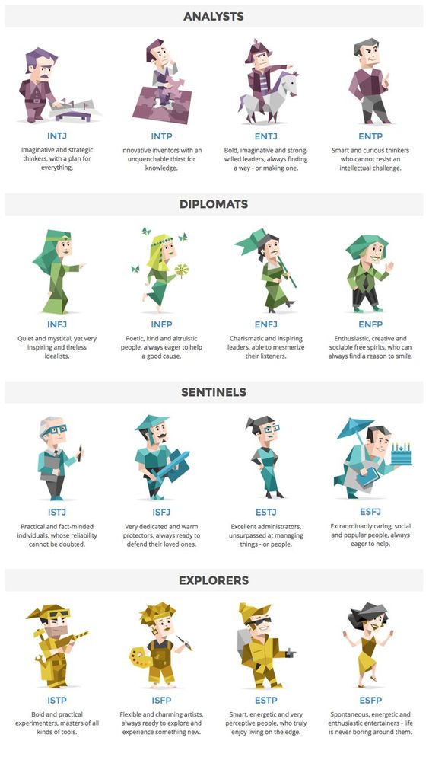
Notes:
https://www.pinterest.com/pin/755197431239691683/

Slide 21
First Indicator I VS. E
I N F P

Slide 22
First Quadrant I VS. E
INFP
Introverted
(PICTURE OF) Student studying QUIETLY at library (introverted)
Extroverted
(PICTURE OF) Sorority/Fraternity boy/girl at parties TALKING to a lot of people

Slide 23
So We Have a Binary Variable
I or E

Slide 24
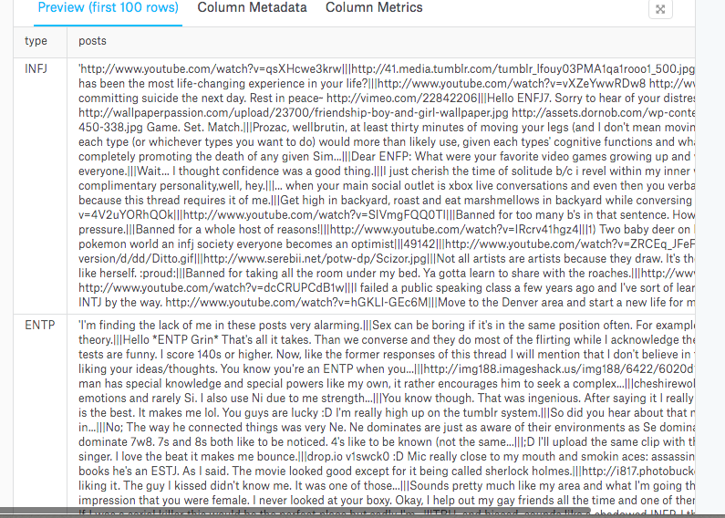
MBTI Dataset
https://www.kaggle.com/datasnaek/mbti-type/data

Slide 25
Do using certain words indicate a certain temperament? Procedure
Clean data
Create a column for I vs. E (binary)
Tokenize/Vectorize dataset (bag of words)
Count words & create giant matrix
Run a logistic regression
Summarize data

Slide 26
MBTI Python CODE Case STudy
Switch Screens

Slide 27
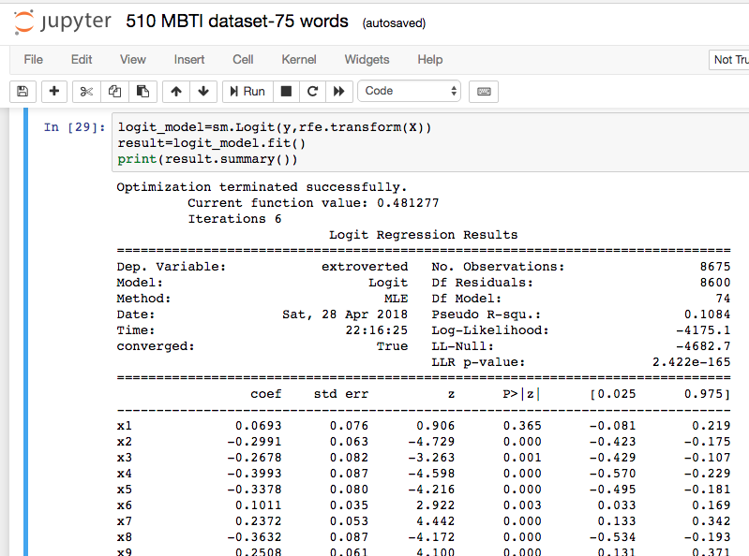

Slide 28
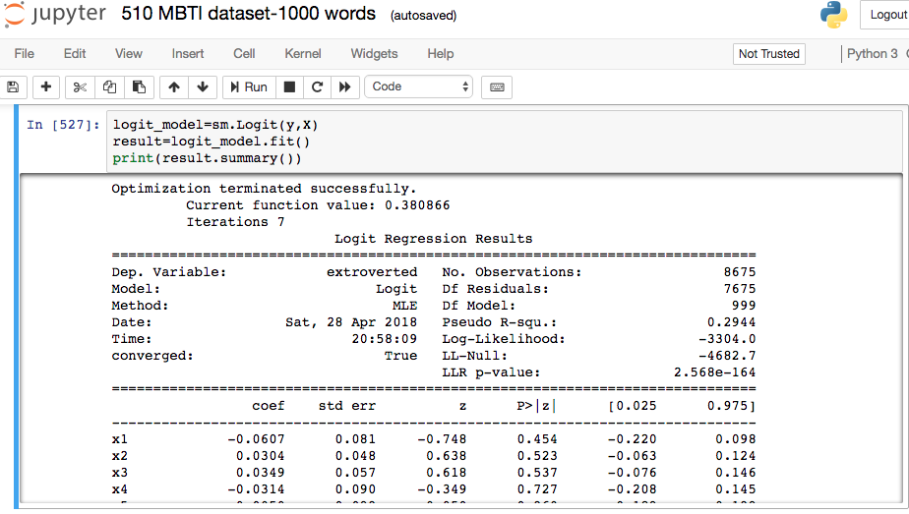

Slide 29
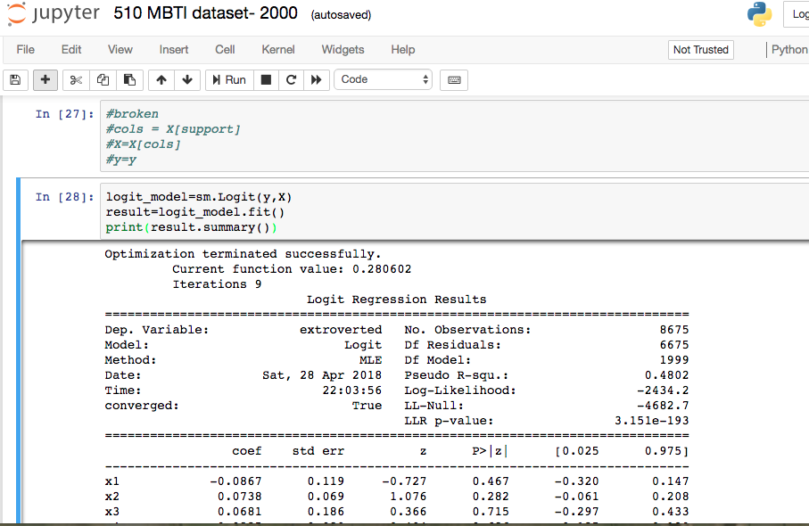

Slide 30
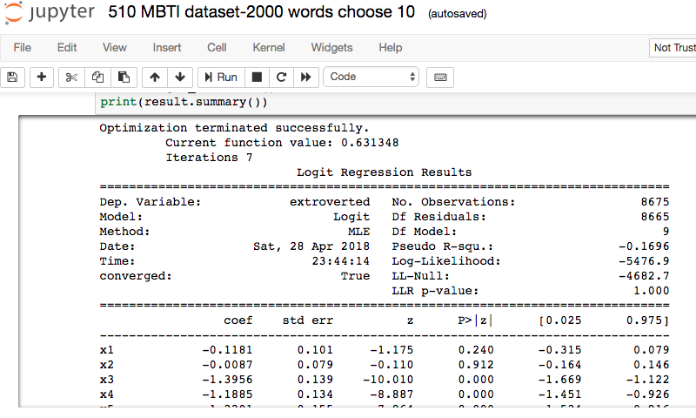

Slide 31

How to predict a categorical response?
Ordered (Ordinal:)
Example of ordinary variables
The following example illustrates the fitting and interpretation of a multiple logistic regression model that involves both quantitative and categorical predictor variables.
· Age (X1): a quantitative variable;
· Socioeconomic status of household. This is a categorical variable with three levels. It is coded by two indicator variables (X2 and X3) as follows:
· City sector (X4): Since there were only two sectors in the study, one indicator variable was used, defined as X4 = 0 for sector 1 and X4 = 1 for sector 2.
The primary purpose of the study was to assess the strength of the association between each of the predictor variables and the probability of a person having contracted the disease.

Slide 32
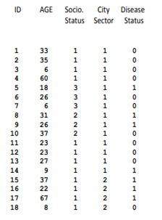
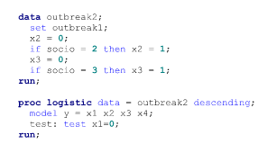
How to predict a categorical response?
ordinal:

Slide 33
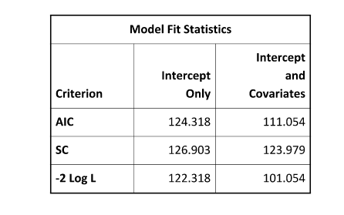
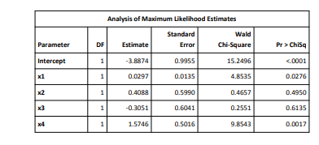
SAS output

Slide 34
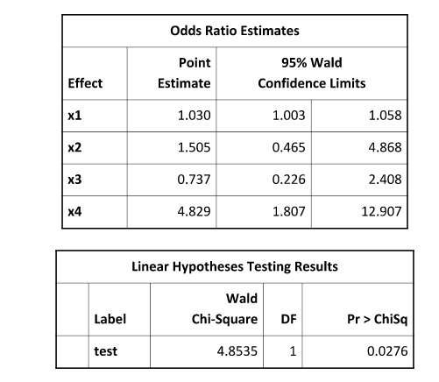

Slide 35
Multinomial Models
Create multiple dummy regressions, each calculated simultaneously.
For multinomial models (more than 1 possible response) ????
https://www.mathworks.com/help/stats/multinomial-models-for-nominal-responses.html
http://amunategui.github.io/multinomial-neuralnetworks-walkthrough/
https://www.theanalysisfactor.com/logistic-regression-models-for-multinomial-and-ordinal-variables/
R walkthrough

Slide 36

A deeper look at Logistic Regression
How do you analyze a logistic regression?
Can we use r squared? Nope. Use Psuedo R^2
http://thestatsgeek.com/2014/02/08/r-squared-in-logistic-regression/

Slide 37
References
https://en.wikipedia.org/wiki/Ordinal_regression
Ordinal Responses
Maybe an example? Which factor effects quality most? (Highest correlation) (https://www.kaggle.com/uciml/red-wine-quality-cortez-et-al-2009)
https://en.wikipedia.org/wiki/Ordered_logit
Example of ordered regression problems:
https://stats.idre.ucla.edu/r/dae/ordinal-logistic-regression/
In SPSS
https://www.ibm.com/support/knowledgecenter/en/SSLVMB_22.0.0/com.ibm.spss.statistics.help/spss/categories/idh_catr.htm
General information on categorical data
http://www.ucd.ie/statdept/classpages/categorical_data_analysis/cda1.pdf

Slide 38
References for R, SAS, & Python
https://www.analyticsvidhya.com/blog/2015/08/comprehensive-guide-regression/
R tutorial on running a logistic regression:
https://www.r-bloggers.com/how-to-perform-a-logistic-regression-in-r/
R tutorial on building a logistic regression from scratch:
https://www.analyticsvidhya.com/blog/2015/10/basics-logistic-regression/
Python walkthrough: https://towardsdatascience.com/logistic-regression-using-python-sklearn-numpy-mnist-handwriting-recognition-matplotlib-a6b31e2b166a
https://towardsdatascience.com/building-a-logistic-regression-in-python-step-by-step-becd4d56c9c8
SAS example:
http://support.sas.com/documentation/cdl/en/statug/63962/HTML/default/viewer.htm#statug_logistic_sect060.htm

Slide 39
Multivariate Regression with Categorical Response
Robert Nakano robertnakano@gmail.com
Sunny Jelokhani
Ziyi Wang
Link to slides: https://tinyurl.com/yatpwo83

